Slide 1
WELCOME
2

Slide 2
Collective Bargaining I: Legal Framework
Introduction to Collective Bargaining Series
FSED
Train-the-trainer

Slide 3
Collective Bargaining: Legal Frameworks
What is the (CB1) course? This course is designed to provide a basic introduction to the legal framework for federal collective bargaining.
Audience The CB1 course is designed for union leaders and activists with little or no experience in federal collective bargaining.
Overview Federal collective bargaining is more restrictive than other types of private or public sector bargaining. Accordingly, federal collective bargaining is a process that can often be confusing or frustrating. This course is designed to give participants basic information on the legal framework for federal collective bargaining so they are better prepared to represent their members at the bargaining table. This session will teach members about your rights as a union negotiator and how they can work through common obstacles to bargaining. This course is the first in a two-part series on Introduction to Collective Bargaining. While this course will teach the basics rules of the road for how to get the agency to sit down and bargain, the next course, Introduction to Collective Bargaining 2: Negotiation Skills and Techniques (CB2), will help participants develop the skills to win the best agreement possible for their members.

Slide 4
Collective Bargaining: Legal Frameworks
Program Learning Objectives After completing this program, participants should be able to: Discuss the collective bargaining roles and requirements for unions and agencies under 5 U.S.C. Chapter 71 Define key terms and concepts used in federal collective bargaining Evaluate common legal strategies and bargaining techniques used in federal collective bargaining.

Slide 5
Collective Bargaining: Legal Frameworks
Program Length This program is designed for 3 days of instruction. The suggested class time is a 9 am – 5 pm schedule.
Number of Participants 10 – 20

Slide 6
What is in the Toolkit:
Instructor Guide
Participant Workbook
Manual
PowerPoint
Reorganization Scenario Video
6

Slide 7
The Instructor Guide
What’s the purpose of this guide? This facilitator guide provides a master reference document to help you deliver the Error! No text of specified style in document. program.
What will I find in the guide? This facilitator guide is a comprehensive package containing The workshop delivery sequence Checklists of necessary materials and equipment Presentation scripts and key points to cover, and Instructions for managing instructional activities.

Slide 8
The Instructor Guide
How is the text laid out in a lesson? Steps within a lesson are placed in a text block like this one. A margin icon is placed to the left of the text block to signal what information the block contains. A list of the margin icons used in this guide is provided below.

Slide 9
The Instructor Guide
How is this guide organized? The first section of the Instructor Guide, from pages 1-67 contains all of the preparation information for the program, such as learning objectives, pre-work, required materials, and room set-up. Finally, the program itself is divided into modules, each of which is comprised of one or more lessons. A module is a self-contained portion of the program, usually lasting anywhere from 2 to 4 hours, while a lesson is a shorter (typically 30 – 60 minutes) topic area. The second section of the Instructor Guide (Appendix B) from pages 68-126 includes a combined Instructor Guide/Participant Workbook for reference when teaching the course.

Slide 10
The Instructor Guide

Slide 11
The Participant Workbook
The participant workbook follows all the material being covered in the presentation. It tracks along with the following: Objectives for each section and activity Short quizzes Activities, and instructions and materials needed for those activities The Instructor Guide will to the Workbook (Ex. “Refer class to page 13 in the Participant Workbook for this activity.”)

Slide 12
The Manual
The manual is the textbook for the course. It contains all of the material being covered in the class. By reviewing the manual, a member can take in all of the substantive material covered in the course. This class, however, is an interactive course, where concepts are drilled through a series of collaborative learning exercises.

Slide 13
The PowerPoint
The PowerPoint presentation complements the Instructor Guide. The Instructor Guide will direct the teacher when to refer students to the PowerPoint (ex. “Show slide 20 Federal Collective Bargaining: Speaking the Language, Knowing the Players”)

Slide 14
The Reorganization Scenario Video
The Reorganization Scenario Video is a supplemental tool for the Reorganization bargaining scenario. It includes some roleplaying, and an imbedded tutorial. The Instructor Guide starts Day 2 with the video, to kick off the exercise (ex. “Bargaining begins with change, show Video PPT 53”)

Slide 15
Everything you need:
3-4 Laptops
5 USB drives
Internet connection
LCD projector and cables to laptop
External/House Speakers (do not rely on laptop speakers)
CB1 Workbook with handouts and exercises
CB1 Course Manual
CB1 Instructor Guide
CB1 PowerPoint Presentation
CB1 Reorganization Scenario Video
5 U.S.C. Chapter 71 Handout
Flipcharts (1 with self-adhesive backing is recommended)
Markers (for the trainer and a few for participant tables)
Painter’s Tape (or something to post flipchart paper)

Slide 16
The Content of the Class
2

Slide 17
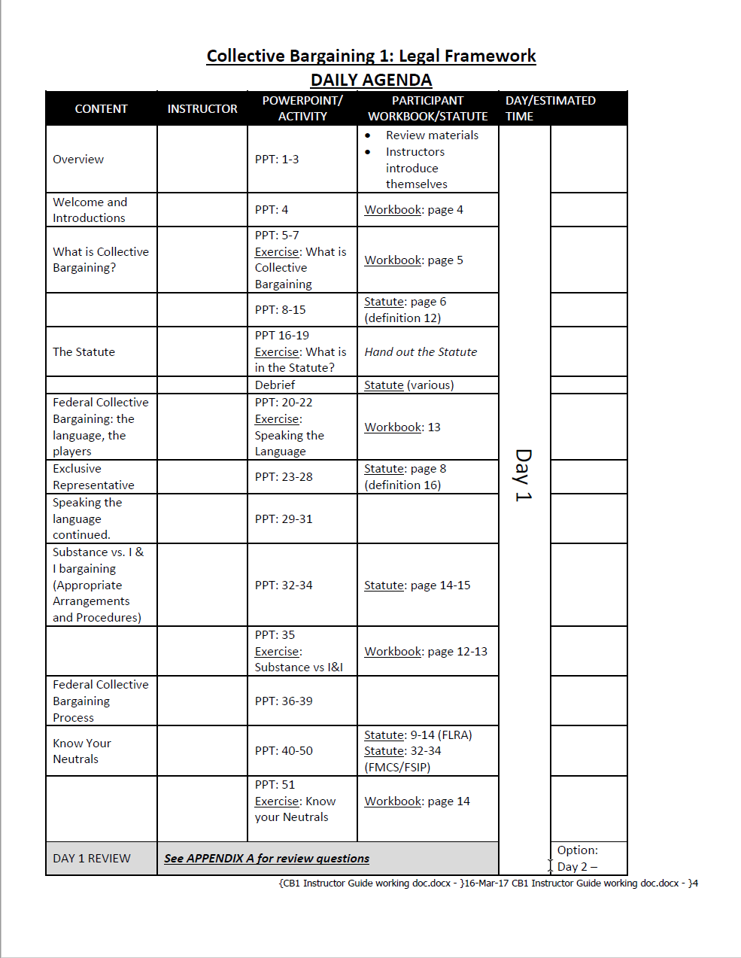
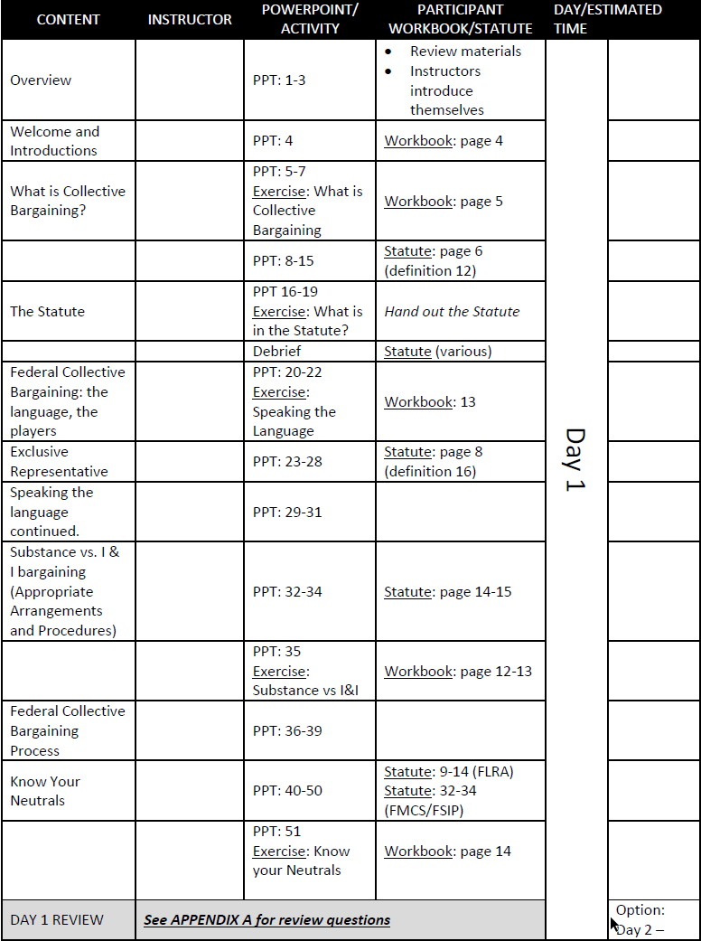
6

Slide 18
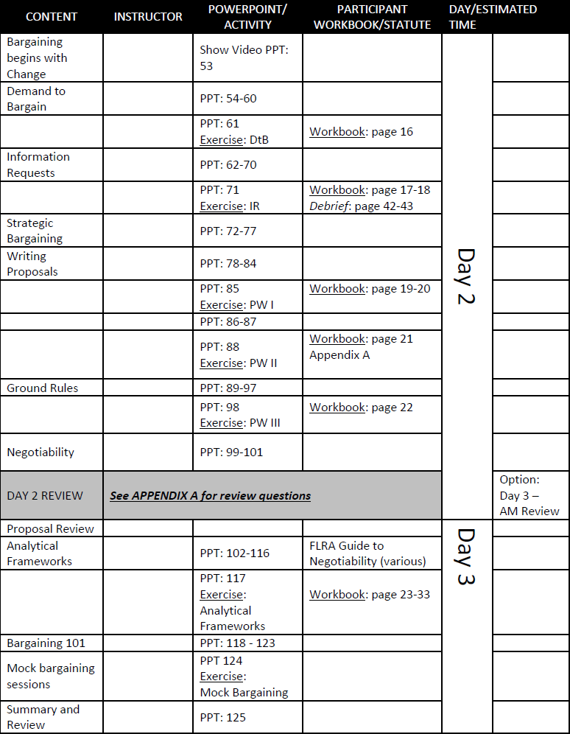
6

Slide 19
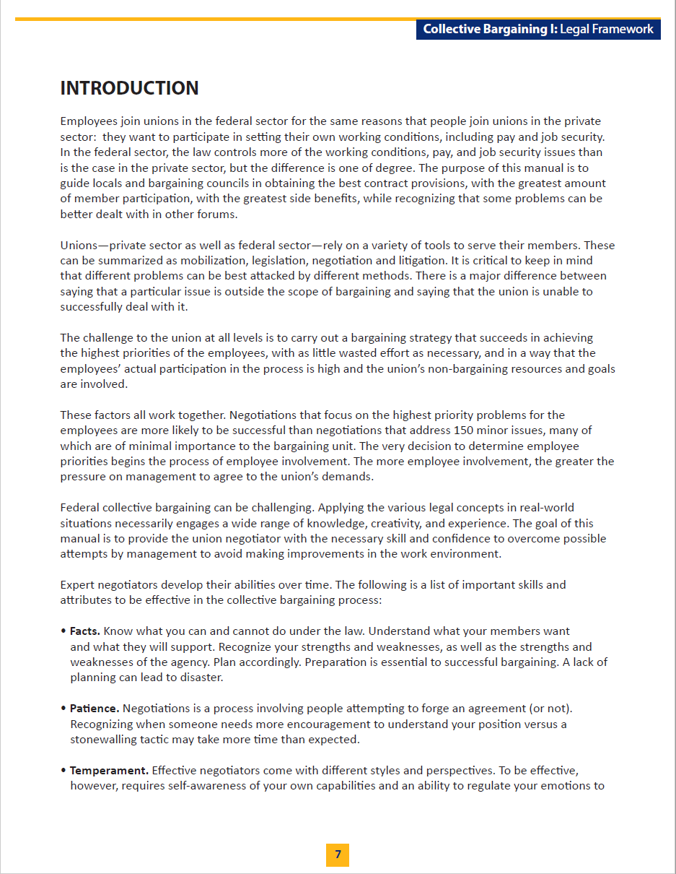
Introduction
Give an overview of the class (PPT 1-3), review materials and introduce yourself Welcome and Introductions Course Overview (Workbook 4)

Slide 20
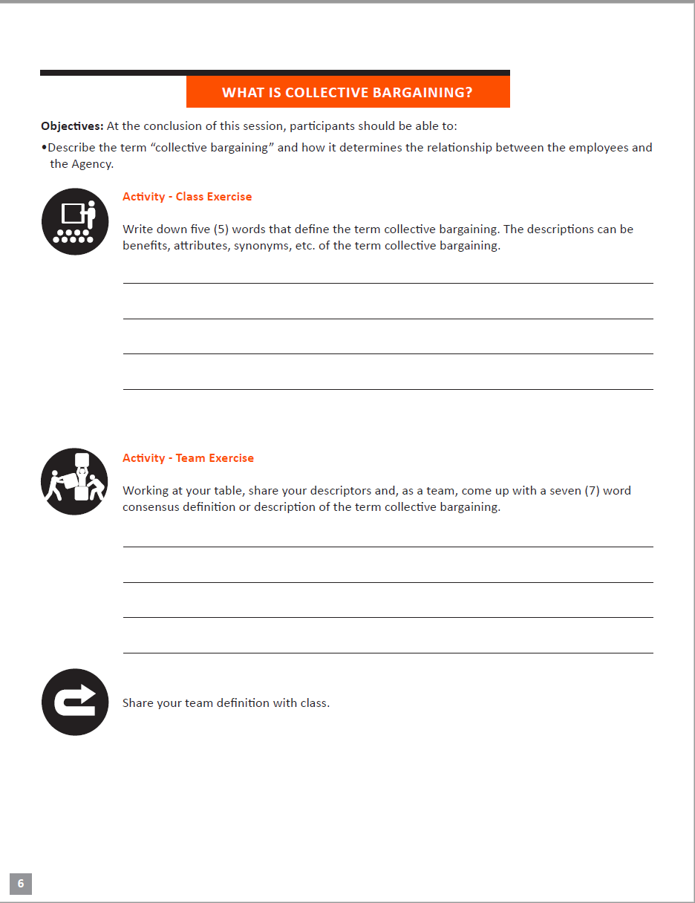
What is Collective Bargaining
Class Exercise;- Class Writes what they think collective Bargaining is (Workbook 5) Instructor reviews statutory definition of collective bargaining, role of bargaining in a union (PPT 5-7)

Slide 21
The Statute
Instructor reviews the Statute in brief (PPT 5-7) Participants answer questions about the statute as a team, using statute as reference (Workbook 7-12)

Slide 22
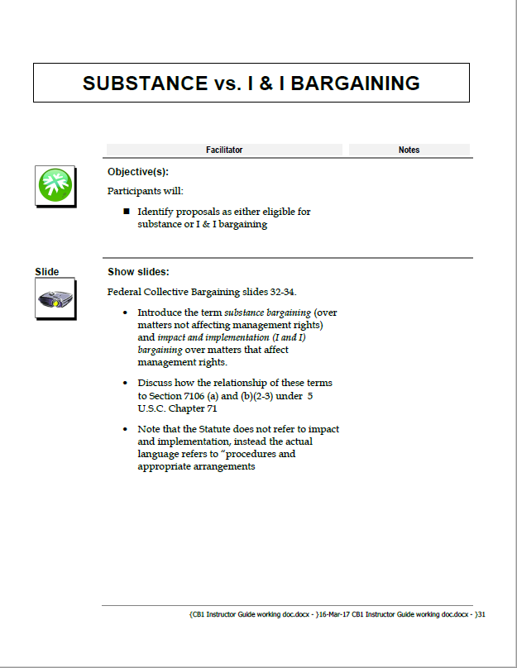
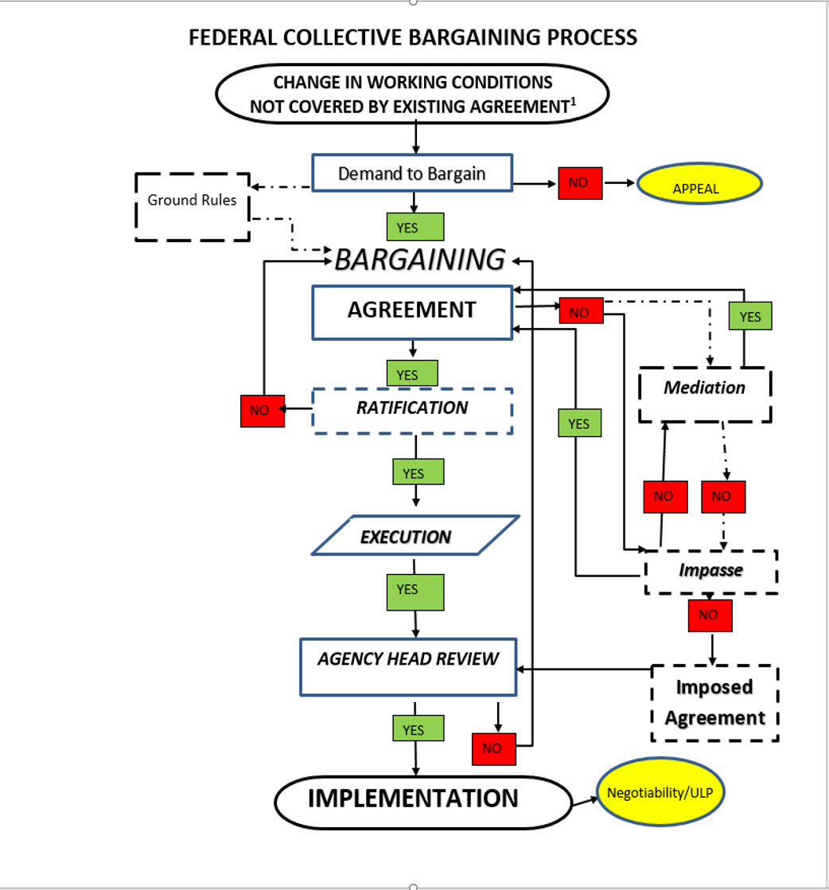
Federal Bargaining Process
Instructor defines some key terms used in describing the participants in the collective bargaining process (PPT 19-22); Participants write short definitions for those terms (Workbook 13) Instructor explains “exclusive representative” (PPT 23-27) Instructor defines more process terms (PPT 28-30) Instructor explains difference between substantive bargaining versus I&I bargaining (PPT 31-34); Participants classify scenarios as relating to substantive bargaining or I&I (Workbook 14-15) Federal Bargaining Process explained in greater detail (PPT 36-39) Know your neutrals (PPT 40-50); exercise identifying appropriate neutral/fact finder (Workbook 16)

Slide 23
Bargaining Begins: PT 1
Instructor shows CB1 Reorganization Scenario Video Instructor reviews the demand to bargain process (PPT 54-60);participants draft demand to bargain for reorg scenario (Workbook 17-18) Instructor reviews requirements and components of information request (PP62-70), participants draft mock information request for reorg scenario (Workbook 19-20) Instructor reviews Strategic Bargaining Process (PPT 72-77)

Slide 24
Analytical Frameworks
1) Instructor reviews reasons agency refuses to bargain, and how to assess and respond to the following (PPT 102-17) Rules and regulations Management rights Permissive subjects of bargaining The Covered-By doctrine Agency Head Review De Minimis Past Practice 2) Participants identify and propose counter-strategies to Agency efforts to refuse to bargain over reorg scenario Workbook (23-35)

Slide 25
Bargaining!
Bargaining 101- Roles, responsibilities and best practices in bargaining (PPT- 118-123) Participants engage in mock Bargaining over reorg scenario (PPT 124) Summary and Review (PPT 125)

